Slide 1


Case Study 2 : Stock Analysis
By Yoong Yuan Zhi

Slide 2
Case Study 2: Stocks Analysis
Business problem :
During a Pandemic, stock prices can drop drastically due to fear and shifts in demand, which calls for portfolio resizing. At the same time, when the stock market crashes, it provides an opportunity to buy undervalued stocks.
Problem statement:
How can investors better position themselves during a Pandemic , so that they can minimize losses and reap huge profits ?
Value proposition :
Investors can better position themselves by understanding
(1) Which sector has the largest drawdown, as it enables investors to reduce their position in these badly affected sectors
(2) How long each sector takes to recover, in order to determine the duration for ROI / Duration to recover losses
(3) Which sector profits the most during Covid-19, to determine which sector to invest in

Slide 3
Data
Source of data :
Steps taken to collect the data + Data quality considerations
Yahoo stock aggregator was chosen as their website reflects the daily stock prices , which is considered 'up to date' for financial reporting
Firstly, Stratified sampling technique was used to select the ETFs
ETFs were first divided into defensive and non-defensive sectors
Then a single ETF from each subcategory (healthcare/retail/energy etc) was chosen to represent the entire industry
Secondly, Equal weighted ETFs were chosen to ensure that the ETFs represented the trends of the entire industry

Slide 4
Data
Steps taken to collect the data + Data quality considerations
Thirdly, ETFs chosen are of substantial capital size, in order to reduce volatility and more accurately reflect the price changes
Moreover, the closing price of each ETF was used to ensure the standardization of data
Lastly, September 2019 was chosen as the starting date as it is one financial quarter before covid-19 started. Thus, ensuring the stock market has not factored in covid-19 in its valuation
Methods taken to organize the data
Conversion to percentage change
As the stock prices were of differing values, they were converted to percentage change to facilitate easy comparison across industries
Organize data by categories and attributes
Related data are aggregated and sorted by dates

Slide 5
Exploratory Data Analysis(1 / 2)
Data integrity
Data cleaning steps we taken to ensure the absence of null , duplicate or missing data
Moreover, the data extraction process was repeated twice to ensure the accuracy of the data
Lastly, the data was reproduced using another stock pricing aggregator called 'morning star' to ensure the validity of the data

Slide 6
Extra details (not part of presentation to stakeholders)
Code used to ensure data integrity :
Missing data check
df.isna().any()
Correct data type check
df.dtypes()
Null data check
df.info()

Slide 7



Exploratory Data Analysis (2/2)
What are the relevant fields
4 fields to help investors gain an edge in the market
What is the initial insight/understanding of the data
(1) Discrete vs continuous
Percentage change across time is a continuous data. Hence a line graph is to be used to visualize the data
Percentage drawdown, time taken to recover and profits are discrete data which is best represented through a bar graph for easy comparison
(2)Categorial vs quantitative
Data within each field can be sorted categorically into "Good, average , bad" . Whereby Good= Green , Average=Yellow , Bad=Red
Time taken to recover back to pre-covid valuation
% Drawdown
Profits since start
Profits since crash

Slide 8
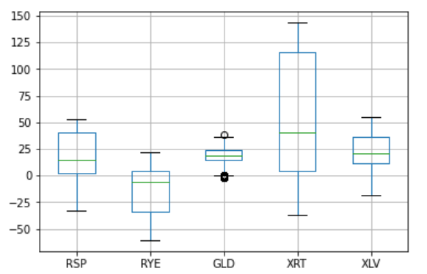
Exploratory Data Analysis (2/2)
(3) Statistical calculations were performed to derive the maximum and minimum value of each field (eg. which industry took the longest time to recover their valuation ) (More info at slide 14)
(4) Outliers check using a boxplot
(There are no significant outliers)

Slide 9
Dashboard
Dashboard 1 :
https://public.tableau.com/app/profile/yuan.zhi2701/viz/Dashboard1_16413765473160/HoweachindustryperformsthroughoutCovid?publish=yes
Dashboard 2 :
Scoring by key factors

Slide 10
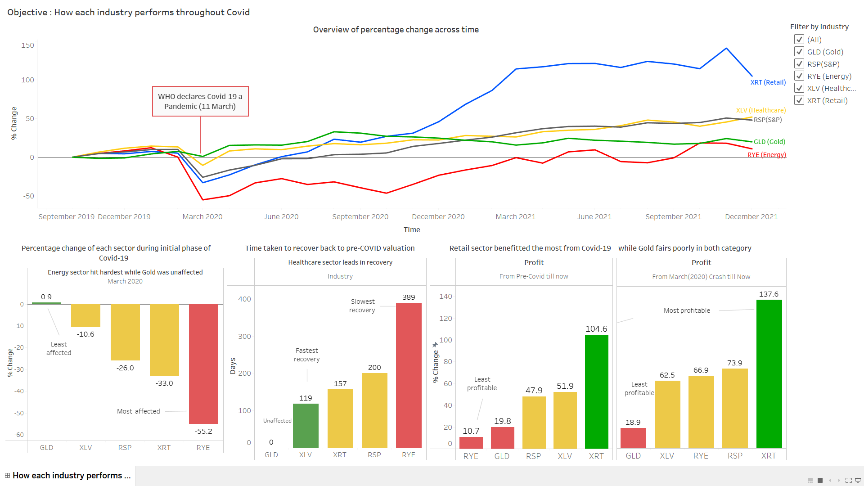

Slide 11
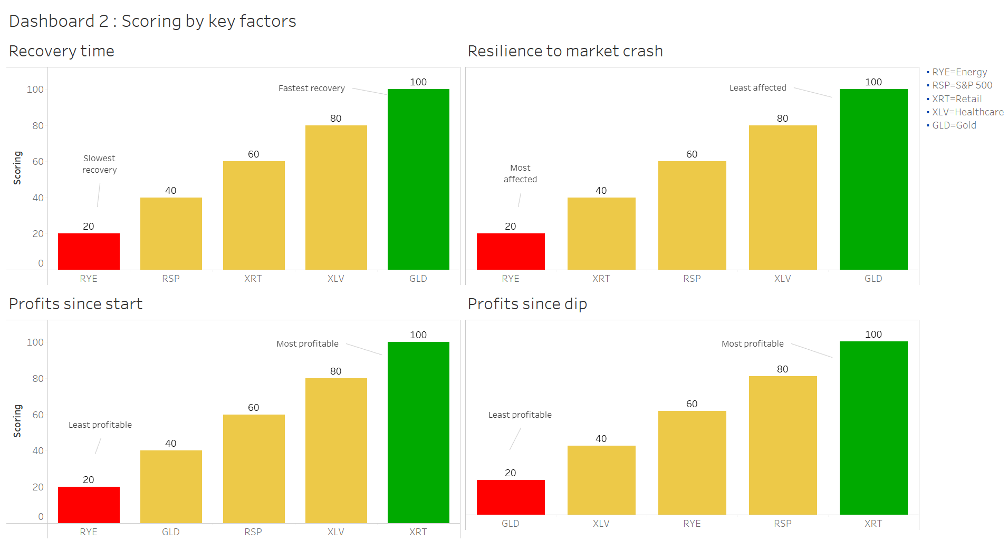

Slide 12
Key Insights
During the initial phase of covid-19 (March 2020) :
In terms of recovery:
Energy sector had the largest % drawdown (-55.2%), and was most affected by covid-19
This is followed by retail (-33%) , S&P (-26%), healthcare (-10.6%)
Gold was the only sector unaffected by the crash , with a positive change of (0.9%)
Lesser drawdown
Greater drawdown
Gold & Healthcare
S&P
Energy & Retail
The healthcare sector was the quickest to recover back to pre-covid valuation (119 days)
This is followed by retail (157), S&P (200)
The energy sector was the slowest to recover , with a significantly longer recovery time of (389 days)
Gold was unaffected , thus it has recovery time of 0
Shorter recovery
Longer recovery
Gold, Healthcare, Retail
S&P
Energy

Slide 13
Key Insights
In terms of overall profits since pre-covid till now :
In terms of profits since March 2020 dip till now :
Visual walkthrough of key insights :
Story link
Retail sector had the largest profits (104.6%)
Followed by healthcare (-51.9%), S&P (-47.9%)
Lastly energy (10.7% ) and Gold (19.8%) had the lowest profits
More profitable
Less profitable
Retail, Healthcare
S&P
Gold, Energy
Retail sector also had the largest profits(136.6%)
Followed by S&P(73.9%), energy (66.9%) , healthcare (62.5%), Gold (18.9%)
Notably, even though energy sector had fared poorly in terms of overall profits (10.7%), it had made a huge recovery since the dip , giving it a significantly higher profit of (66.9%)
More profitable
Less profitable
Retail
S&P
Healthcare, Energy, Gold

Slide 14
Recommendations
Portfolio allocation strategy
During periods of market uncertainty (March 2020 crash) :
Reasons to reduce exposure to energy sector
Largest drawdown (-55.2%)
Longest valuation recovery time (389 days)
Reasons to reallocate capital to Gold sector
Positive returns during market crash (0.9%)
Reasons to reallocate capital to Healthcare sector
Minimal drawdown (-10.6%) , which qualifies as a defensive stock
Fastest recovery time (119 days)
With a fast recovery time , investors should hold onto their healthcare stock during the crash , as it does not take long for the valuation to recover and eventually yield profits

Slide 15
Recommendations
Portfolio allocation strategy
What stocks to buy after the crash :
Reasons to buy Retail stock
Largest profits since dip (136.6%)
2nd fastest recovery time (157 days) , which reduces time for Return on investment (ROI)
Reasons to avoid Gold stock
It is a stable stock throughout covid-19, evident in having the lowest profit since dip (18.9%)
Reasons to buy Energy stock despite having the longest recovery time
Firstly , the long recovery time is expected given that energy stock had a significant drawdown during the initial phase
Secondly, the energy stock's large drawdown allows investors to yield huge returns during its recovery. This is evident in its significantly higher return of (66.9%) after the dip

Slide 16
Conclusion
Impact of recommendations
Other considerations / supplementary resources
Minimized losses during market crashes and ability to pick highly profitable stocks
Cons of ETFs
While ETFs helps to reduce risk through diversification, investors will benefit less when a particular company does well (compared to directly investing in the company)
Macro-economic factors
While historic price pattern is useful in predicting future price action, many other macro-economic factors play an important role in determining stock prices.
Eg. Demand level , monetary policies (interest rates, money supply , inflation), supply chain disruption etc

Slide 17
Conclusion
Some challenges in applying data analytics skills to this project
Real-time updating of charts
Charts are currently generated manually from past datasets. More advanced coding skill is needed to build a real time graph that updates automatically
Complexity of working in new environment
There were tasks that were conceptually simple but more tedious to accomplish with the Python syntax.
However, it was a good learning opportunity and I found it more manageable as I enhanced my understanding of Python

Slide 18
THANK YOU

